Slide 1
Distinct Laminar Processing of Local and Global Context in Primate Primary Visual Cortex
Presented by: Xiaoqi Zhang
2020/09/19

Slide 2
Overview
The paper studies the laminar processing of Surround Suppression (SS) in primary visual cortex (V1), whose laminar connectivity is well known.
The study adapted linear microelectrode array (LMA) to simultaneously record activities across layers, under different situations of visual stimulations.

Slide 3
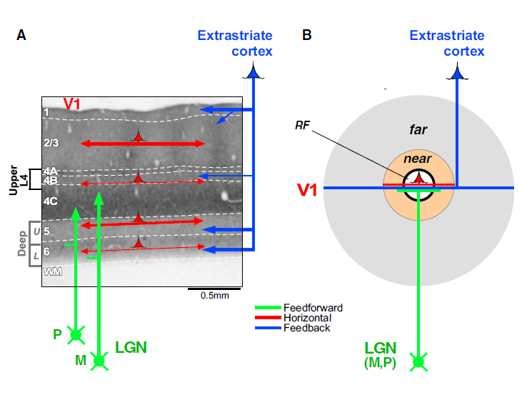
Hypothetical laminar-specific connectivity in V1

Slide 4
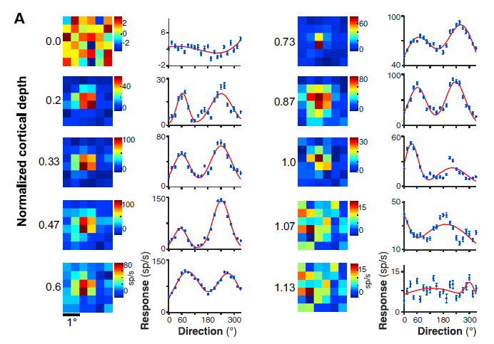
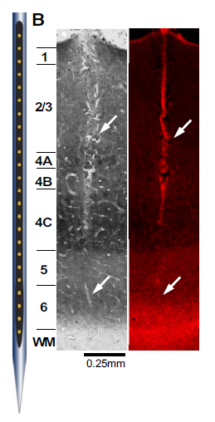
Verticality of penetration is verified with multiple evidence

Slide 5
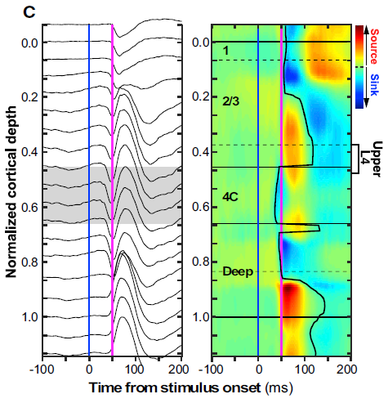
Onset latency of current sink in Current Source Density (CSD) as a measurement of layer boundaries
Notes:
input L4C can be identified as the location of the earliest current sink followed by a reversal to current source in response to RF stimulation
CSD, defined as the second spatial derivative of LFP signals, produces a map of current sinks (negative voltage fluctuations) and sources (positive fluctuations) as a function of time;

Slide 6
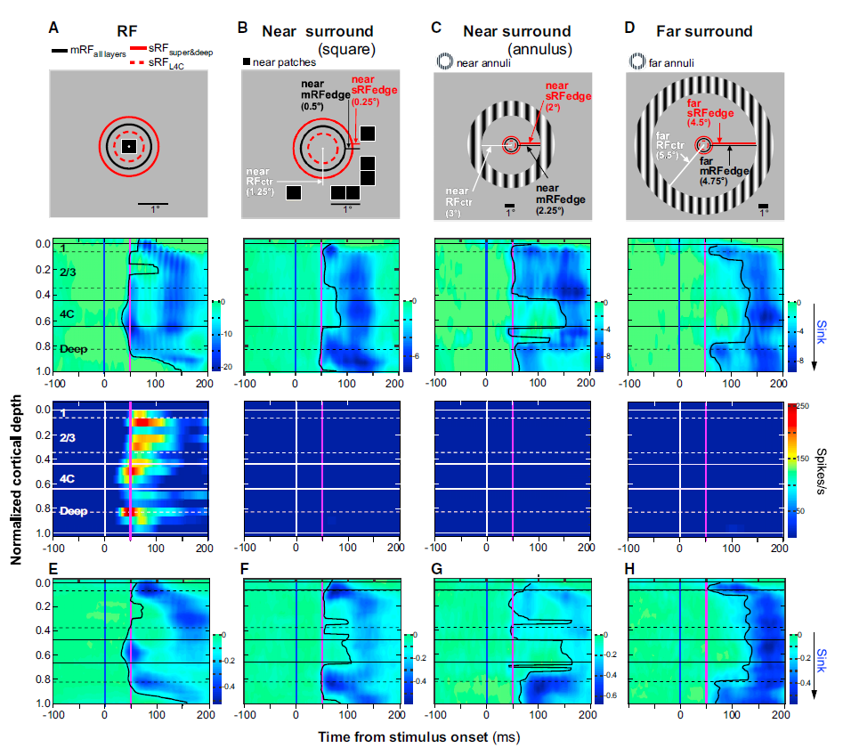
Various surround stimulations generate different laminar patterns of CSD signal
Notes:
To identify the circuits carrying visual signals from the surround to the recorded column
This approach, i.e., measuring the onset latency of current sinks that reflect the net post-synaptic potentials
Small square stimuli inside the columnar mRF (Figure 3A, top) evoked the fastest CSD current sink in L4C, followed by sinks in deep and then superficial layers
Early activation of L4C by RF stimulation can be explained by feedforward activation of this layer
the earliest current sinks were observed in L2/3 and deep layers almost at the same time (Figure 3B, middle).
However, unlike the small square, the annulus evoked more robust activation of upper-L4
Stimulation of the far-surround with an annular grating evoked the earliest CSD signals in feedback-recipient layers, i.e., L1 and the lower deep layers
the CSD sinks it evoked reflect subthreshold responses.

Slide 7
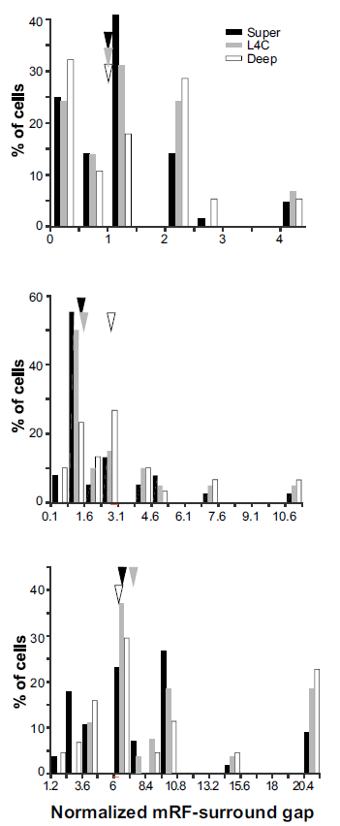
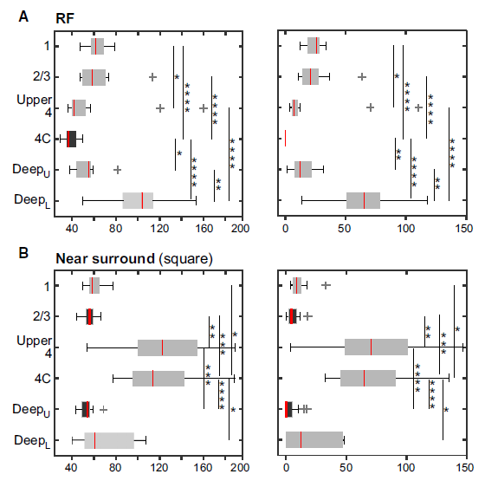
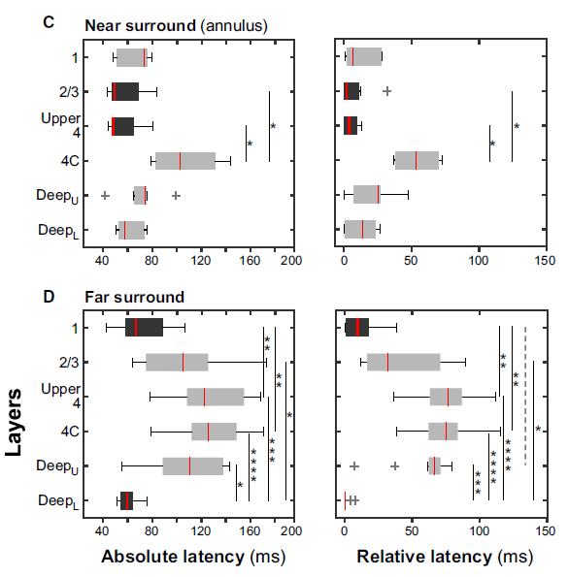
Differences in latency between near-surround and far-surround stimulation suggest multiple circuits are involved for different contexts
Notes:
First, L4C was activated significantly faster by a stimulus inside the RF compared to any surround stimulus.
Second, L2/3 and DeepU were activated significantly faster by near than far-surround stimuli.
Third, upper-L4 was activated significantly faster by near annuli than near squares or far annuli; however, all other layers were activated at similar latencies by near-surround squares and annuli.
Fourth, L1 and DeepL were activated at similar latencies by stimuli in the RF, near-surround, or farsurround, suggesting that activation of L1 and DeepL by these stimuli may occur via similar circuits (see Discussion).
In summary, these data demonstrate that, in V1, stimuli in the near and far-surround evoked distinct laminar patterns of CSD signals, suggesting involvement of different circuits and layers in the processing of local and global context

Slide 8
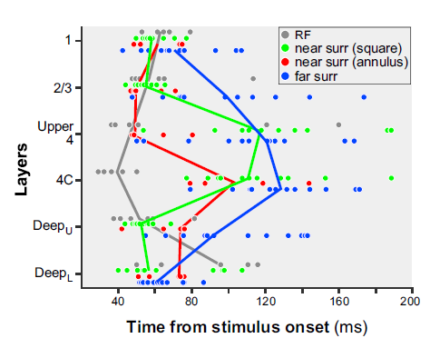
Differences in latency between near-surround and far-surround stimulation suggest multiple circuits are involved for different contexts

Slide 9
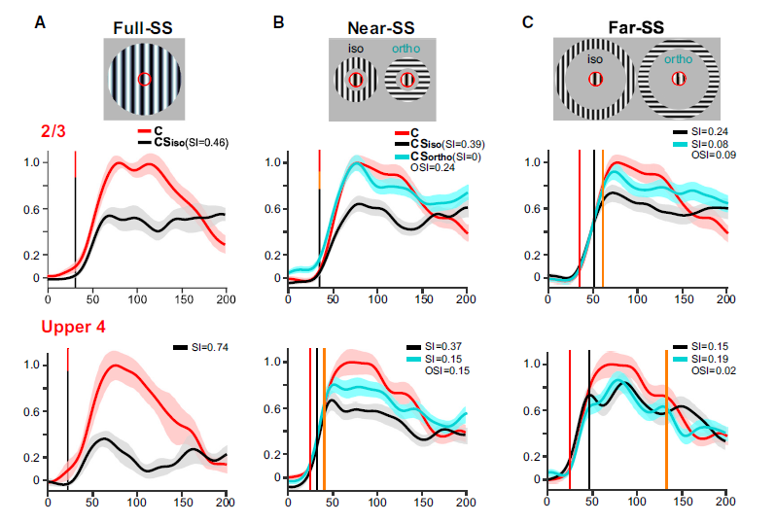
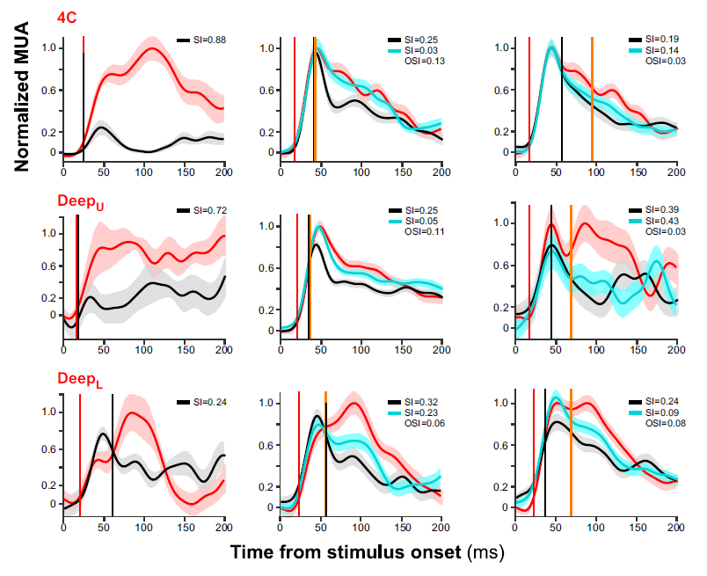
Combining RF and surround stimulation reveals the onsets of iso-oriented suppression and tuned suppression
Notes:
A:
the earliest suppression occurred in layers DeepU, 4C, and upper-4 and at the same time as the onset of the center only response (Figure 6A).
In L2/3, suppression occurred later, but it still coincided with the onset latency of the center-only response in L2/3.
The co-occurrence in time of SS with visually evoked responses in V1 strongly suggests that the origin of this suppression is subcortical, and therefore the earliest suppression in V1 is inherited from the LGN as reduced feedforward excitation.
B:
the onset of suppression was markedly delayed relative to the onset of the center-only response as well as relative to the suppression onset caused by the large patch stimulus.
Moreover, near-SS in L4C was also delayed relative to the onset of near-SS in all other layers, except DeepL; the earliest near-SS occurred in superficial layers and upper deep layers.
These observations suggest that suppression is not inherited from the LGN, Rather, this form of suppression is likely generated within V1, outside L4C.
Tuned near-SS in all layers, except upper-4, appeared at about the same time as the earliest suppression, suggesting that the earliest suppression generated within cortex is orientation tuned.
C:
earliest suppression in deep layers, and latest suppression in L4C (Figure 6C).
Far suppression in all layers was significantly delayed relative to the onset of center-only responses in the same layers;
moreover, in all layers, but DeepL, far suppression was also delayed relative to suppression caused by large grating patches or near-surround annuli within the same layers.
These results suggest that far-SS is also generated intracortically outside L4C, and is delayed relative to near suppression.

Slide 10
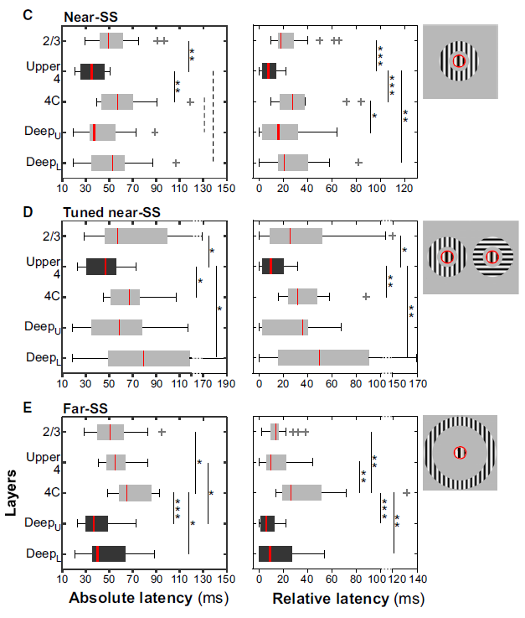
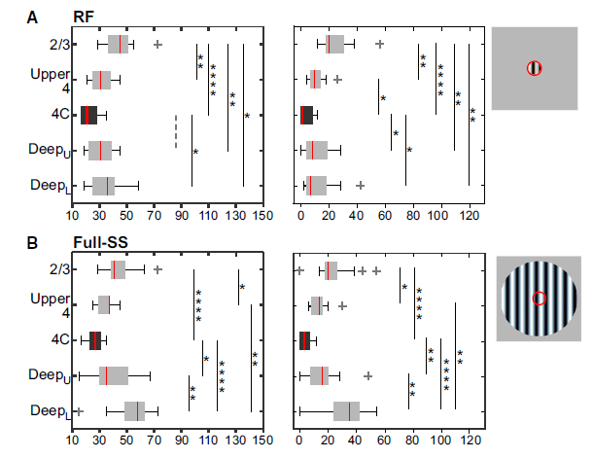
Differences in onset of suppression implicate different sources of suppression from LGN and intracortical origins
Notes:
In summary, responses to large gratings covering the RF and full surround, near-SS, and far-SS showed distinct laminar profiles of onset latencies.

Slide 11
Pairwise Ranksum test across layers and stimuli contrasts the onsets of events
“First, the onset of spiking responses in L4C following RF stimulation was the fastest evoked event in V1, and this event occurred at a similar latency as full-SS in L4C, suggesting an LGN origin of the earliest SS.”
“Second, full-SS in L4C occurred significantly faster than near-SS, tuned-SS, or far-SS in any layer, suggesting the latter three forms of suppression are generated intracortically.”
“Third, near-SS occurred first in upper-L4, [later in L4C than responses to RF stimulation and the onset of full-SS]. However, near-SS in upper-L4 was not significantly faster than the earliest far-SS in deep layers. This suggests that the earliest SS caused by near and far annuli … occurs at similar latencies, albeit in distinct layers. ”
“Fourth, there was no significant difference in the earliest onset latency of suppression between near-SS and tuned near-SS.”
“Fifth, far-SS occurred first in deep layers, about 16–19 ms after onset in L4C of responses to RF stimulation, and about 10–13 ms after the onset in L4C of full-SS.”

Slide 12
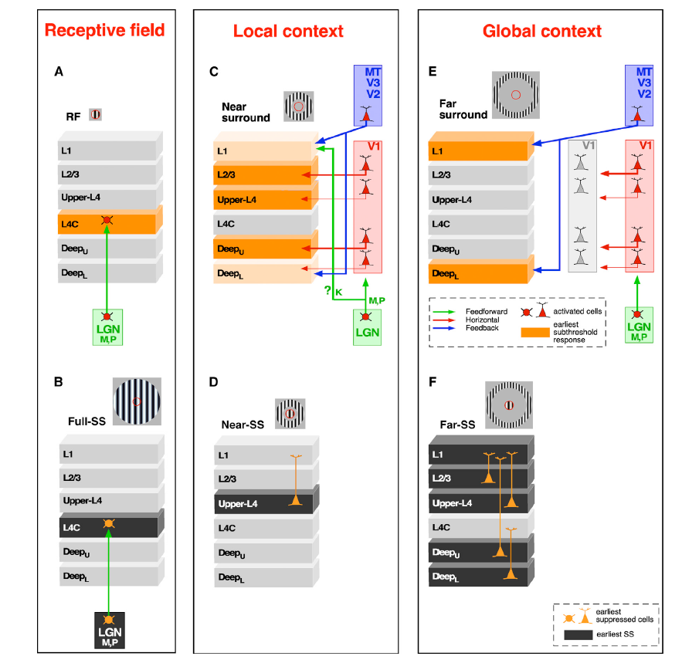
Summary: laminar processing of RF response and contextual suppression
Notes:
(A) Stimuli inside the RF evoke the earliest CSD and spiking signals in L4C, which are relayed to the V1 center column by faster M and P (relative to K) geniculate pathways (green arrows).
(B) A large stimulus encompassing the RF and full surround causes SS of LGN afferents to the center V1 column, resulting in withdrawal of afferent excitation to L4C, where suppression first emerges in V1.
(C) Visual stimuli in the near-surround (beyond the extent of M and P geniculocortical afferents), in the absence of RF stimulation, activate neurons outside the center hypercolumn in V1 (red shading), in extrastriate cortical areas (blue shading), and possibly LGN K-layers (green shading); these surround signals are conveyed to the superficial and deep layers of the center V1 column by multiple long-range connections, including V1 horizontal connections (red arrows), feedback connections (blue arrows), and K1-2 afferents (green arrow).
(D) SS in response to center and near-surround stimuli first emerges in superficial layers, particularly upper-L4.

